Slide 1
STEEL SURFACE DEFECT MACHINE LEARNING
TERM PROJECT
AUGUST 21, 2019
BASED ON THE NORTHEASTERN UNIVERSITY (NEU) DEFECT DATABASE
GROUP MEMBERS:
MASTHANAIAH PELLURI ( MAST311@GMAIL.COM )
NARESH PATEL ( NP.PATEL@OUTLOOK.COM )
KERIM TERZIOGLU ( KTERZIOGLU@YAHOO.COM )
JITENDRAKUMAR PRAJAPATI ( JEETPRAJAPATI@GMAIL.COM )

Slide 2
Content
Project Overview
Dataset Overview
Data Analysis / Feature Engineering
Models
Deep Learning using Convolutional Neural Network
Model Evaluation
Challenges
Conclusion

Slide 3
Project Overview
Steel is the most important building materials of modern days. Surface quality of steel is essential for steel industry and detecting quality issue is very challenging.
Goals and Objective :
The challenge is to detect and classify steel surface defects using machine and deep learning. Accuracy metrics is used to evaluate the models.
Accuracy = Total Number of Correct Predictions / Total number of Images

Slide 4
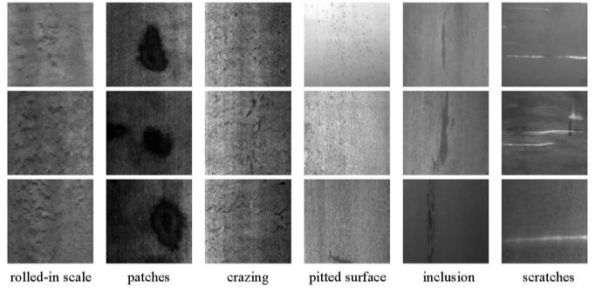
Dataset overview
In the NEU surface defect database, six kinds of typical surface defects of the hot-rolled steel strip are categorized:
RS - rolled-in scale
PA - patches
CR - crazing
PS - pitted surface
IN - inclusion
SC - scratches
The database includes 1,800 grayscale images: 300 samples each of the six typical surface defects categorized above.
http://faculty.neu.edu.cn/yunhyan/NEU_surface_defect_database.html

Slide 5
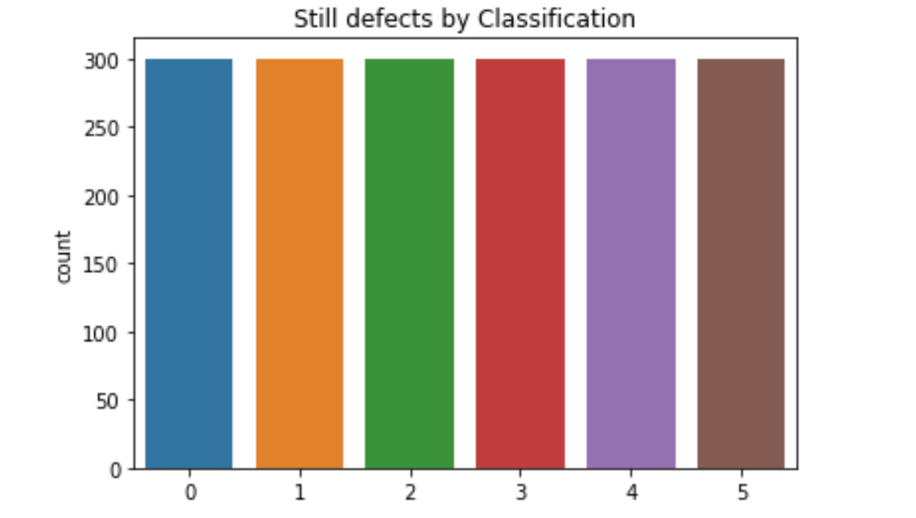
Data Analysis / Feature Engineering
In the Northeastern University (NEU) surface defect database, six kinds of typical surface defects of the hot-rolled steel strip are collected, i.e., rolled-in scale (RS), patches (Pa), crazing (Cr), pitted surface (PS), inclusion (In) and scratches (Sc). The database includes 1,800 grayscale images: 300 samples each of six different kinds of typical surface defects. Dataset is well balanced as we can see in below image
0 - Crazing
1 - Inclusion
2 - Patches
3 - Pitted surface
4 - Rolled-in-scale
5 - Scratches

Slide 6
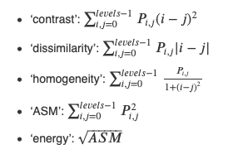
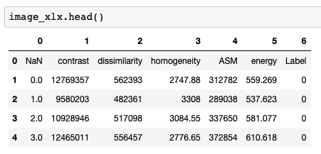
Data Analysis / Feature Engineering
Utilized 2 scikit-image.org APIs:
greycomatrix - calculate the grey-level co-occurrence matrix (GLCM) for a given image
A grey level co-occurrence matrix is a histogram of co-occurring grayscale values at a given offset over an image.
greycoprops - calculate the texture properties of a GLCM
*ASM : Angular Second Moment
More info on link GLCM Book : Practical Computer Vision Applications Using Deep Learning with CNNs

Slide 7
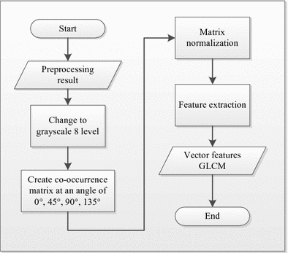
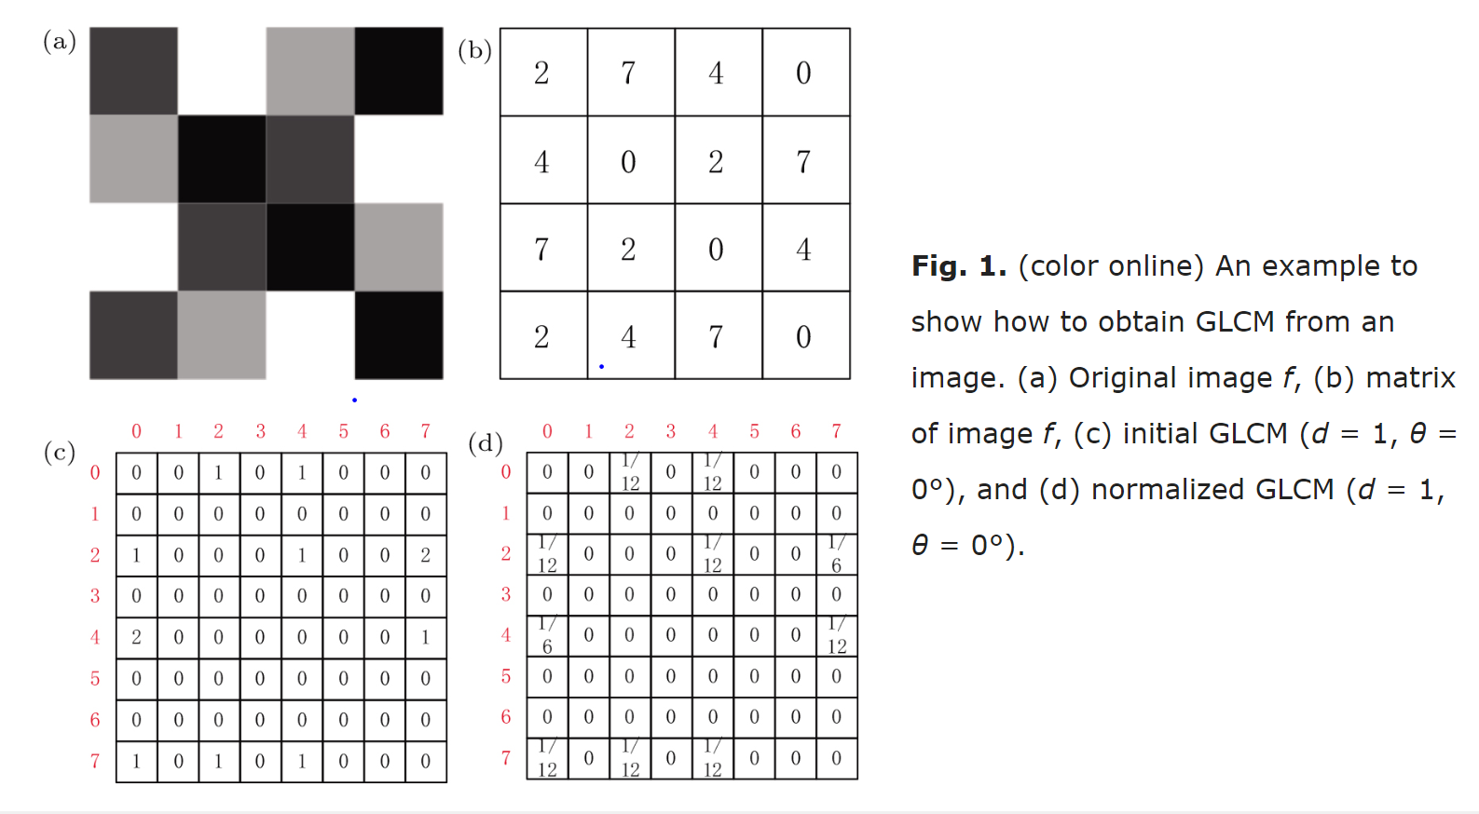
Data Analysis / Feature Engineering
Sources https://link.springer.com/chapter/10.1007/978-981-10-7242-0_7
http://cpb.iphy.ac.cn/article/2017/1901/cpb_26_9_098104.html#

Slide 8
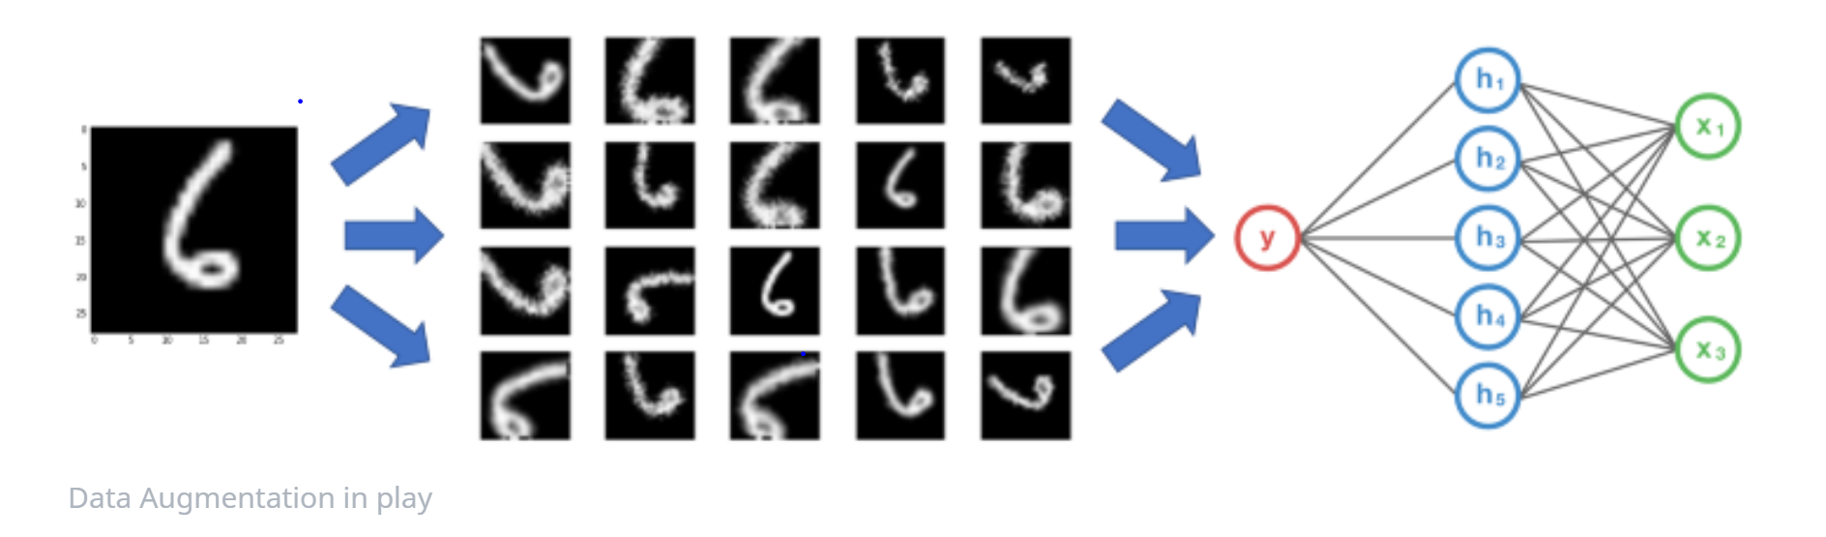
Data Analysis / Feature Engineering
Data Augmentation :
To train convolutional neural network, we have used data augmentation strategy.
Data augmentation is strategy that is used for increasing the size of a training dataset by creating modified images without collecting new data. Example of data augmentation techniques : Rotating, Cropping, padding and flipping(horizontally or vertically) the images
Sources : https://machinelearningmastery.com/how-to-configure-image-data-augmentation-when-training-deep-learning-neural-networks/
https://bair.berkeley.edu/blog/2019/06/07/data_aug/
https://nanonets.com/blog/data-augmentation-how-to-use-deep-learning-when-you-have-limited-data-part-2/

Slide 9
Models
KNN
Random Forest
Decision Tree with Boosting
SVM with Grid Search
CNN with Data Augmentation
CNN without Data Augmentation

Slide 10
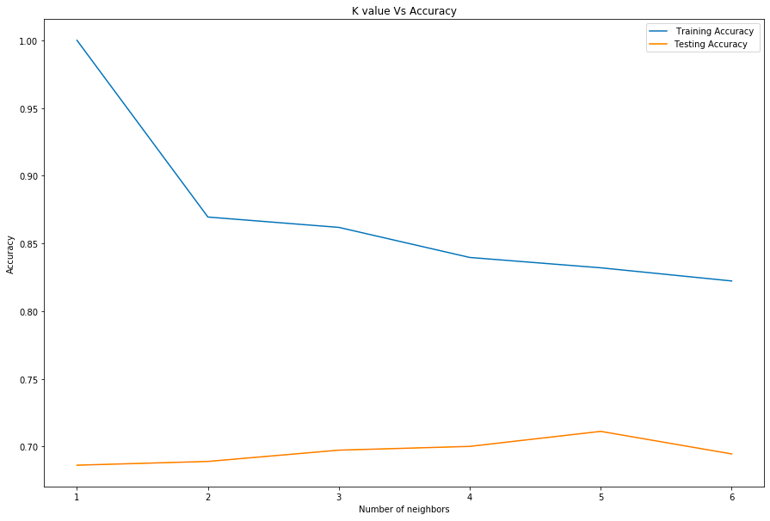
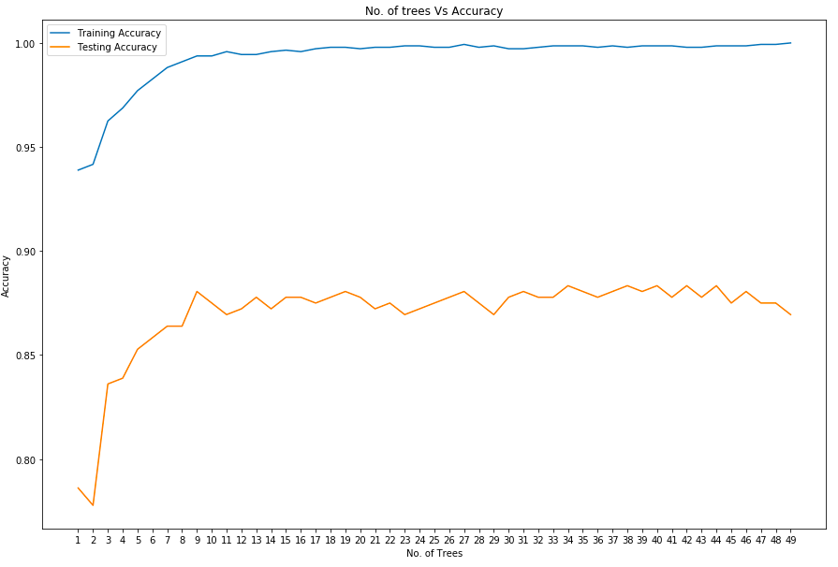
Model Evaluation
KNN: Varying Number of Neighbors, K=5
Random Forest: Number of Trees = 34

Slide 11
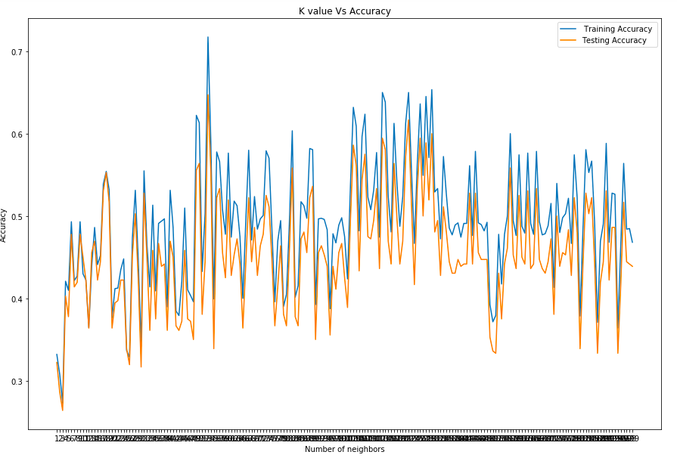
Models Evaluation
Decision Tree with Boosting: K=53

Slide 12
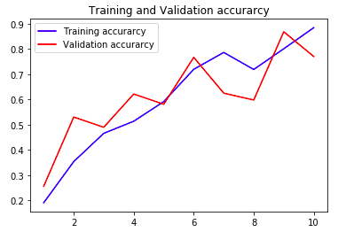
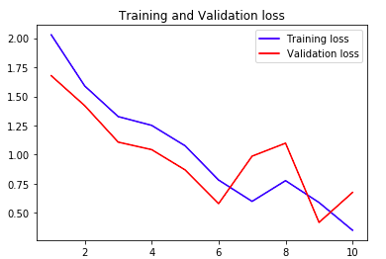
Deep Learning using Convolutional Neural Network
CNN with Data Augmentation

Slide 13
Models Evaluation
Models
 | ACCURACY | PARAMETERS
KNN | 71.1% | K=5
Random Forest | 88.3% | Number of Trees=34
Decision Tree with Boosting | 64.7% | K=53
SVM with Grid Search | 0.17% | C': 0.001, 'gamma': 0.001
CNN with Data Augmentation* | 75.55% | Conv2D, Dropout (2 layers each)
CNN without Data Augmentation | 88.06% | Conv2D, Dropout (2 layers each)
Data Augmentation was introduced for the Neural Network.

Slide 14
Challenges
Grayscale Images
Extracting Features of images
Models performance due to Grayscale Images converted to 3 channels
Models performance after Image augmentation

Slide 15
Conclusion
Based on our research and after utilizing the techniques learned during the class, our conclusion is that the Random Forest model has the best accuracy score and hence can be treated as a Best Model for this dataset
The features were extracted using GLCM
Learned how to use CNN for smaller dataset
Future Usage and Enhancements:
Use images process for Kaggle Competition
Use different technique to get better performance of the models

